Slide 1


<Name>
<Date>

Slide 2

Outline
Executive Summary
Introduction
Methodology
Results
Conclusion
Appendix

Slide 3
Executive Summary
Summary of methodologies
Data Collection through API and Web Scraping
Data Wrangling
Exploratory Data Analysis with SQL
Exploratory Data Analysis with Data Visualization
Interactive Visual Analytics with Folium
Machine Learning Prediction
Summary of all results
Exploratory Data Analysis result
Interactive analytics in screenshots
Predictive Analytics result from Machine Learning Lab

Slide 4
Introduction
SpaceX is a revolutionary company who has disrupt the space industry by offering a rocket launches specifically Falcon 9 as low as 62 million dollars; while other providers cost upward of 165 million dollar each. Most of this saving thanks to SpaceX astounding idea to reuse the first stage of the launch by re-land the rocket to be used on the next mission. Repeating this process will make the price down even further. As a data scientist of a startup rivaling SpaceX, the goal of this project is to create the machine learning pipeline to predict the landing outcome of the first stage in the future. This project is crucial in identifying the right price to bid against SpaceX for a rocket launch.
The problems include:
Identifying all factors that affect the landing outcome.
The relationship between each variables and how it is affecting the outcome.
The best condition needed to increase the probability of successful landing

Slide 5

Section 1

Slide 6
Methodology
Executive Summary
Data collection methodology:
Data has been collected querying the SpaceX REST API and scraping data from the SpaceX Wikipedia page
Perform data wrangling
Data was processed to identify and prepare the variable that represent the outcome of each launch
Perform exploratory data analysis (EDA) using visualization and SQL
Perform interactive visual analytics using Folium and Plotly Dash
Perform predictive analysis using classification models
Training and performance evaluation for different classification algorithms to select the best one

Slide 7
Data Collection
Data collection is the process of gathering and measuring information on targeted variables in an established system, which then enables one to answer relevant questions and evaluate outcomes. As mentioned, the dataset was collected using the SpaceX REST API and scrapping the SpaceX Wikipedia page
For the SpaceX REST API, we used Http Get request to retrieve the data then, we decoded the response content as Json and turn it into a pandas DataFrame object to simplify the data clean up and preparation.
We collected additional in formation scrapping the SpaceX Wikipedia we page,using the BeautifulSoup to extract the launch records from the web page

Slide 8
Data Collection – SpaceX API
Collecting SpaceX data consuming the SpaceX API, via Http requests
Different API endpoints for different data (rockets, launchpads, payloads, etc.)
Converting Http responses from Json to Python Pandas DataFrames
Cleaning up the data
Python notebook: https://github.com/federicoorlandini/IBMDataScience/blob/main/AppliedData%20ScienceCapstone/jupyter-labs-spacex-data-collection-api.ipynb
#----- GETTING THE DATA -----
# Get the data using Http GET request static_json_url='https://cf-courses-data.s3.us.cloud-object-storage.appdomain.cloud/IBM-DS0321EN-SkillsNetwork/datasets/API_call_spacex_api.json' response = requests.get(static_json_url)
#----- CONVERTING DATA TO DATAFRAMES -----
# Use json_normalize meethod to convert the json result into a dataframe data = pd.json_normalize(response.json())
#----- DATA CLEAN UP -----
# Lets take a subset of our dataframe keeping only the features we want and the flight number, and date_utc. data = data[['rocket', 'payloads', 'launchpad', 'cores', 'flight_number', 'date_utc']]
# We will remove rows with multiple cores because those are falcon rockets with 2 extra rocket boosters and rows that have multiple payloads in a single rocket. data = data[data['cores'].map(len)==1] data = data[data['payloads'].map(len)==1]
# Since payloads and cores are lists of size 1 we will also extract the single value in the list and replace the feature. data['cores'] = data['cores'].map(lambda x : x[0]) data['payloads'] = data['payloads'].map(lambda x : x[0])
# We also want to convert the date_utc to a datetime datatype and then extracting the date leaving the time data['date'] = pd.to_datetime(data['date_utc']).dt.date
# Using the date we will restrict the dates of the launches data = data[data['date'] <= datetime.date(2020, 11, 13)]

Slide 9
Data Collection - Scraping
Get the SpaceX Wikipedia web page content (https://en.wikipedia.org/wiki/List_of_Falcon_9_and_Falcon_Heavy_launches)
Read the data contained in the main table in the web page using BeautifulSoap Python library
Python notebook: https://github.com/federicoorlandini/IBMDataScience/blob/main/AppliedData%20ScienceCapstone/jupyter-labs-webscraping.ipynb
# Get the web page content static_url = https://en.wikipedia.org/w/index.php?title=List_of_Falcon_9_and_Falcon_Heavy_launches&oldid=1027686922 response = requests.get(static_url)
# Use BeautifulSoap to navigate the HTML page bs_object = BeautifulSoup(response.content) html_tables = bs_object.find_all('table’)
# Parse the column name from the HTML table for header_item in html_tables[2].find_all('th’): name = extract_column_from_header(header_item) if( name is not None and len(name) > 0 ): column_names.append(name)
# Parse the data in the HTML table rows for table_number,table in enumerate(bs_object.find_all('table',"wikitable plainrowheaders collapsible")): # get table row for rows in table.find_all("tr"): #check to see if first table heading is as number corresponding to launch a number if rows.th: if rows.th.string: flight_number=rows.th.string.strip() flag=flight_number.isdigit() ...other code

Slide 10
Data Wrangling
Data Wrangling is the process of cleaning and unifying messy and complex data sets for easy access and Exploratory Data Analysis (EDA)
Data wrangling process key steps:
Identify and calculate the percentage of the missing values in each attribute in the dataset
Identify which columns are numerical and categorical
Calculate the number of launches on each site
Calculate the number and occurrence of mission outcome per orbit type
Create a landing outcome label from Outcome column
Jupyter notebook: https://github.com/federicoorlandini/IBMDataScience/blob/main/AppliedData%20ScienceCapstone/labs-jupyter-spacex-Data%20wrangling.ipynb

Slide 11
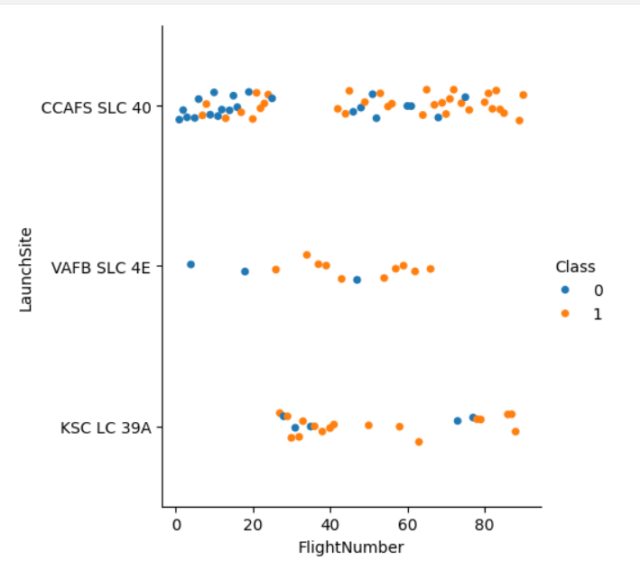
EDA with Data Visualization
We used scatter graph to investigate the relationship between the attributes such as between:
Payload and Flight Number.
Flight Number and Launch Site.
Payload and Launch Site.
Flight Number and Orbit Type.
Payload and Orbit Type.
Scatter plots show dependency of attributes on each other and they are very useful in finding which factors affecting the most to the success of the landing outcomes
Jupyter notebook: https://github.com/federicoorlandini/IBMDataScience/blob/main/AppliedData%20ScienceCapstone/jupyter-labs-eda-dataviz.ipynb

Slide 12
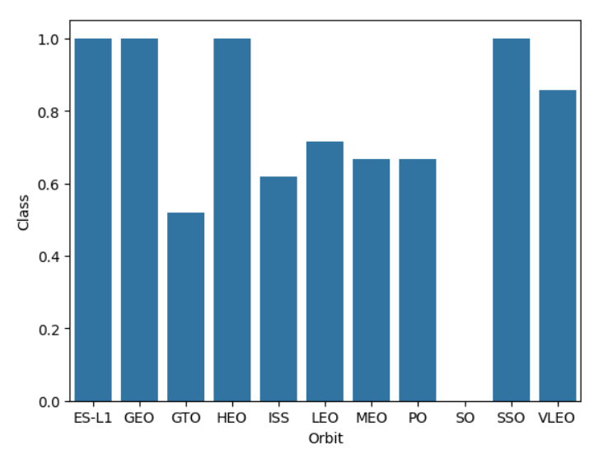
EDA with Data Visualization
Once we get a hint of the relationships using scatter plot, we will then use further visualization tools such as bar graph and line plots graph for further analysis.
In this case, we will use the bar graph to determine which orbits have the highest probability of success.
We then use the line graph to show the launch success yearly trend.
We then use Feature Engineering to be used in success prediction in the future module by created the dummy variables to categorical columns.
Jupyter notebook: https://github.com/federicoorlandini/IBMDataScience/blob/main/AppliedData%20ScienceCapstone/jupyter-labs-eda-dataviz.ipynb

Slide 13
EDA with SQL
Storing the data in a relational database and using SQL, we have been able to better understand the data in the dataset. For example:
Displaying the names of the launch sites.
Displaying 5 records where launch sites begin with the string ‘CCA’.
Displaying the total payload mass carried by booster launched by NASA (CRS).
Displaying the average payload mass carried by booster version F9 v1.1.
Listing the date when the first successful landing outcome in ground pad was achieved.
Listing the names of the boosters which have success in drone ship and have payload mass greater than 4000 but less than 6000.
Listing the total number of successful and failure mission outcomes.
Listing the names of the booster_versions which have carried the maximum payload mass.
Listing the failed landing_outcomes in drone ship, their booster versions, and launch sites names for in year 2015.
Rank the count of landing outcomes or success between the date 2010-06-04 and 2017-03-20, in descending order.
Jupyter notebook: https://github.com/federicoorlandini/IBMDataScience/blob/main/AppliedData%20ScienceCapstone/jupyter-labs-eda-sql-coursera_sqllite.ipynb

Slide 14
Build an Interactive Map with Folium
We used maps to investigate potential correlation between lunch success rate and the launch site location
We marked each site's location on a map using site's latitude and longitude coordinates using red and green markers and MarkerCluster objects on the map
We marked the success/failed launches for each site on the map
We calculated the distances between a launch site to its proximities
We then used the Haversine’s formula to calculated the distance of the launch sites to various landmark to find answer to the questions of:
How close the launch sites with railways, highways and coastlines?
How close the launch sites with nearby cities?
Jupyter notebook: https://github.com/federicoorlandini/IBMDataScience/blob/main/AppliedData%20ScienceCapstone/lab_jupyter_launch_site_location.ipynb

Slide 15
Build a Dashboard with Plotly Dash
We built an interactive dashboard with Plotly dash which allowing the user to analyze the data using a graphical interface.
We plotted pie charts showing the total launches by a certain sites.
We plotted scatter graph showing the relationship with Outcome and Payload Mass (Kg) for the different booster version.
URL python application:
https://github.com/federicoorlandini/IBMDataScience/blob/main/AppliedData%20ScienceCapstone/spacex_dash_app.py
URL screenshots:
https://github.com/federicoorlandini/IBMDataScience/blob/main/AppliedData%20ScienceCapstone/Dashboard%20-%20screenshot%201.PNG
https://github.com/federicoorlandini/IBMDataScience/blob/main/AppliedData%20ScienceCapstone/Dashboard%20-%20screenshot%202.PNG

Slide 16
Predictive Analysis (Classification)
Building the Model
Load the dataset into NumPy and Pandas
Transform the data and then split into training and test datasets
Select which type of ML algorithm to use
Set up GridSearchCV to optimize the hyperparameters and fit the dataset
Evaluating the Model
Check the accuracy for each model
Get tuned hyperparameters for each type of algorithms.
Plot the confusion matrix
Improving the Model
Use Feature Engineering and Algorithm Tuning
Find the Best Model
The model with the best accuracy score will be the best performing model
URL Jupyter notebook: https://github.com/federicoorlandini/IBMDataScience/blob/main/AppliedData%20ScienceCapstone/SpaceX_Machine_Learning_Prediction_Part_5.jupyterlite.ipynb

Slide 17
Results
Exploratory data analysis results
Interactive analytics demo in screenshots
Predictive analysis results

Slide 18

Section 2

Slide 19
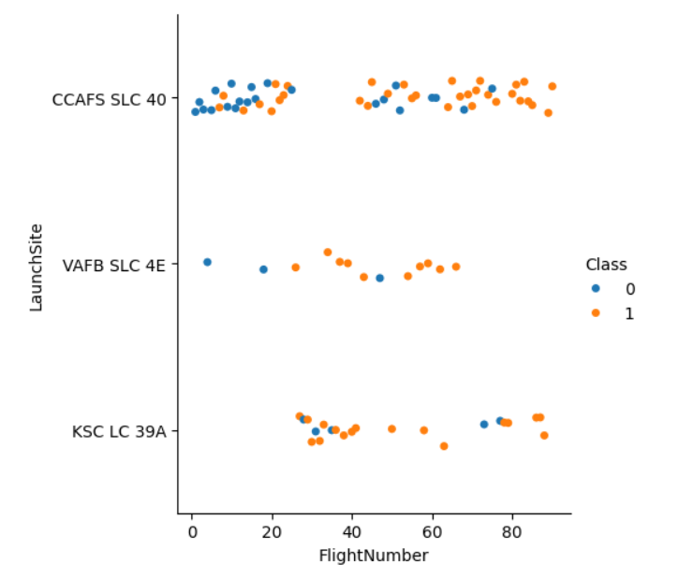
Flight Number vs. Launch Site
This scatter plot shows that the larger the flights amount of the launch site, the greater the success rate will be, even if site CCAFS SLC40 shows the least pattern of this

Slide 20
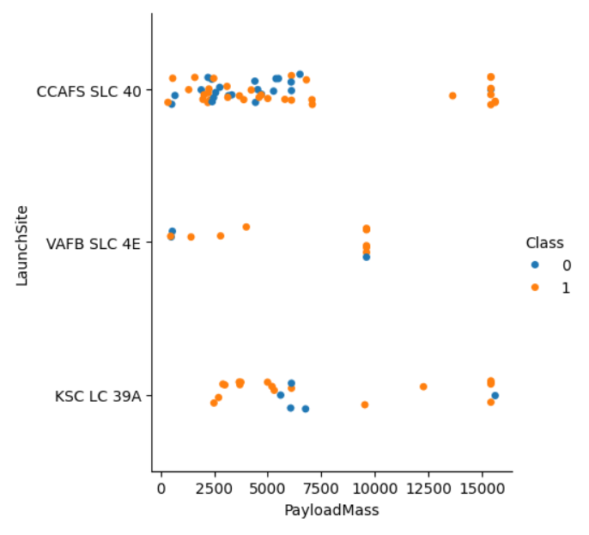
Payload vs. Launch Site
This scatter plot shows that the success rate is higher if the Payload Mass is greater than 7000 kg.

Slide 21
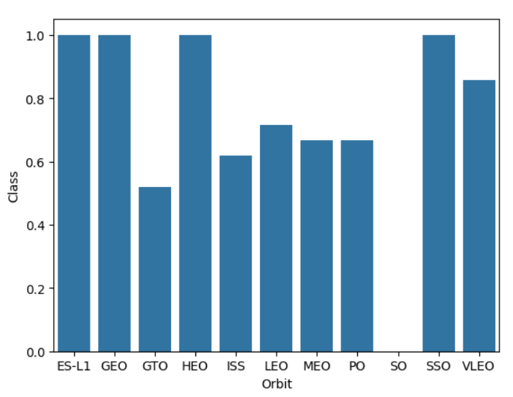
Success Rate vs. Orbit Type
This bra graph shows the correlation between the orbits and the landing outcomes. The figure shows that some orbits has 100% success rate such as SSO, HEO, GEO AND ES-L1 while SO orbit produced 0% rate of success.
However some of this orbits has only 1 occurrence such as GEO, SO, HEO and ES-L1 which mean that we need more data to enrich our dataset to see pattern or trend before we draw any conclusion.

Slide 22
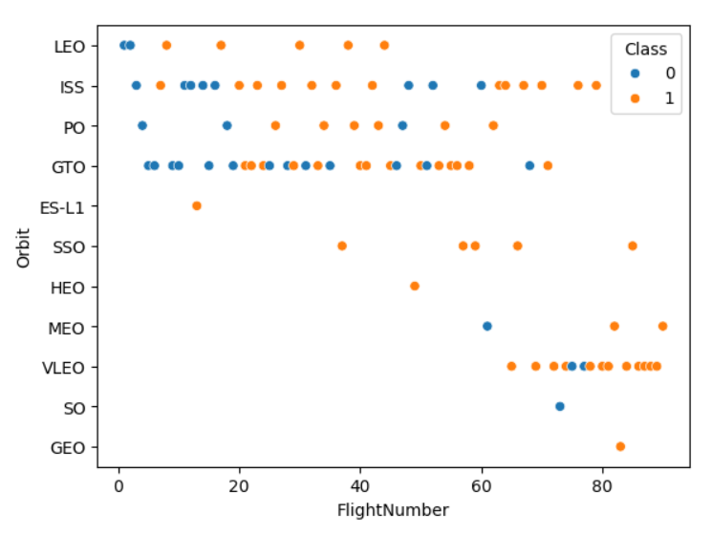
Flight Number vs. Orbit Type
This scatter plot shows that in general larger the flight number on each orbits, the greater the success rate.
However, the GTO orbit seems to be the exception since it doesn’t show the same trend.
Some of the orbit types have only one occurrence of data and they should be excluded by the statement as a bigger data set is needed

Slide 23
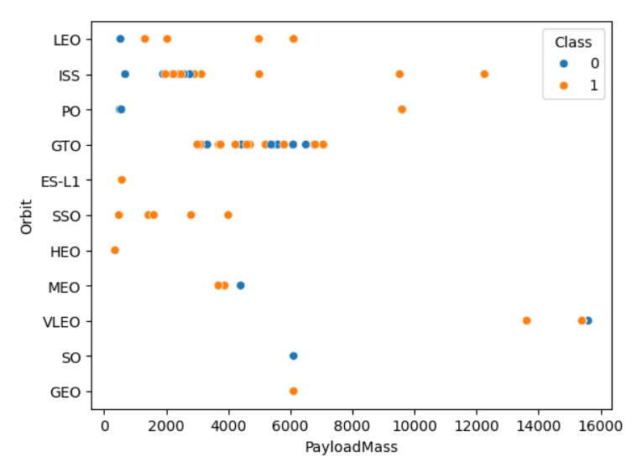
Payload vs. Orbit Type
With heavier payloads the successful landing or positive landing rate are more for Polar, LEO and ISS, while it has negative impact on MEO and VLEO orbit.
For GTO we cannot distinguish this well as both positive landing rate and negative landing are both there here.

Slide 24
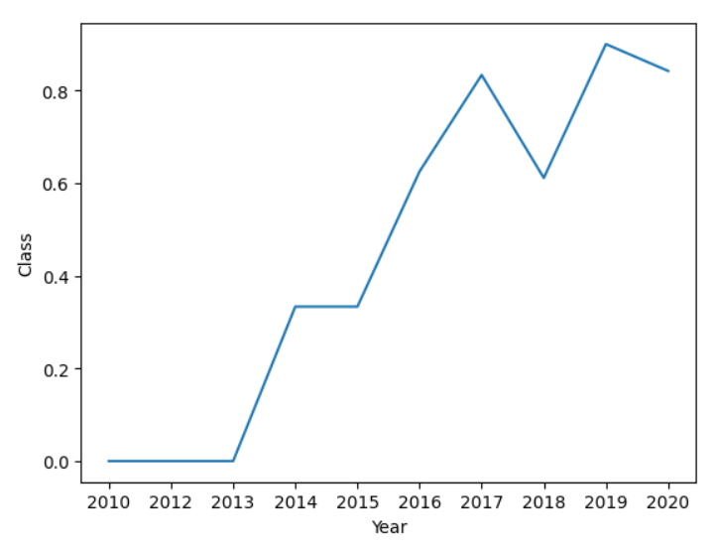
Launch Success Yearly Trend
This figures clearly shows the increasing trend from the year 2013 until 2020, with a slightly decrease in 2018.
However, the launch success rate in the last years is close to 100%.

Slide 25
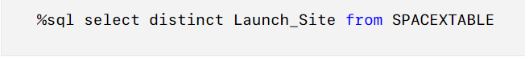
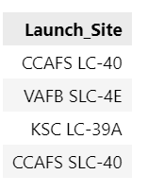
All Launch Site Names
We found the list of all the launch site names loading the dataset in a relational database (SQLite) and using the SQL DISTINCT statement to retrieve the list:
Present your query result with a short explanation here

Slide 26
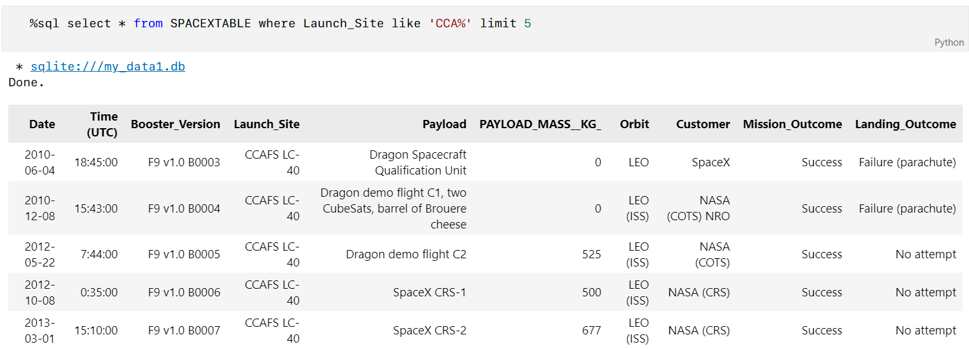
Launch Site Names Begin with 'CCA'
Using the dataset data imported in the relational database, we also found the list of the first 5 names of the launch sites where the site name begin with ‘CCA’. We used the combination of the LIKE statement and the wildcard ‘%’

Slide 27
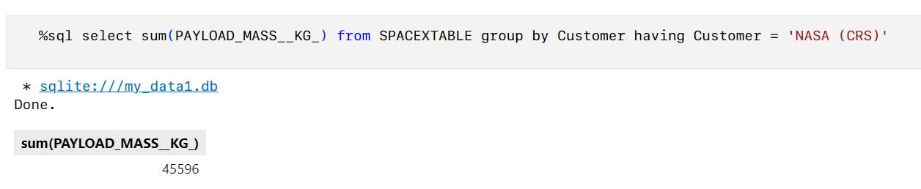
Total Payload Mass
We were also able to calculate the total amount of Payload Mass (in Kg) that have been carried by boosters launched by NASA (CRS) using the SUM() fucntion to sum all the payloads in the result set

Slide 28
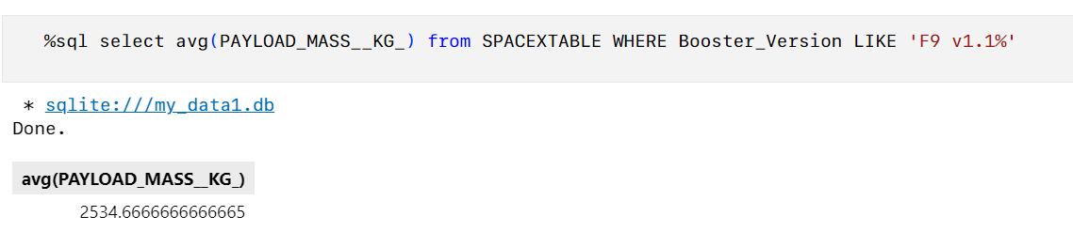
Average Payload Mass by F9 v1.1
The average payload mass carried by booster F9 v1.1 is equal to 2534,67 Kg using the AVG() function to compute the average and the LIKE statement with wildcard ‘%’ to filter the data

Slide 29
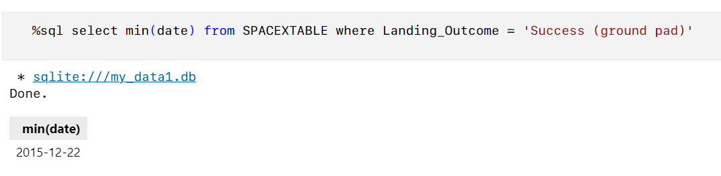
First Successful Ground Landing Date
The first succesful landing outcome in ground pad was achieved on the 22nd December 2015, using the MIN() function

Slide 30
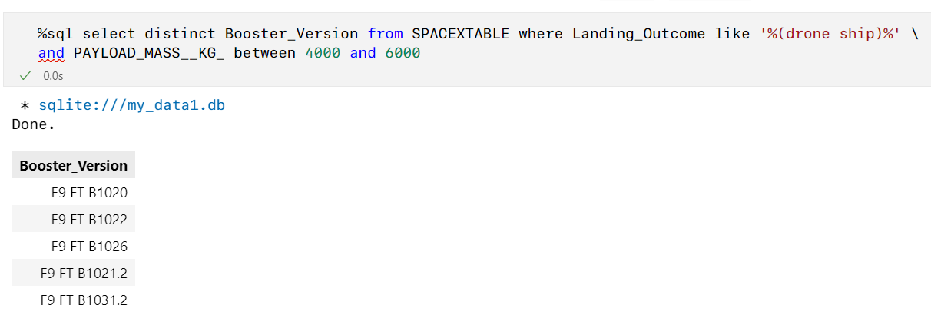
Successful Drone Ship Landing with Payload between 4000 and 6000
This is the list of the names of boosters which have successfully landed on drone ship and had payload mass greater than 4000 but less than 6000, using the BETWEEN statement in the WHERE condition

Slide 31
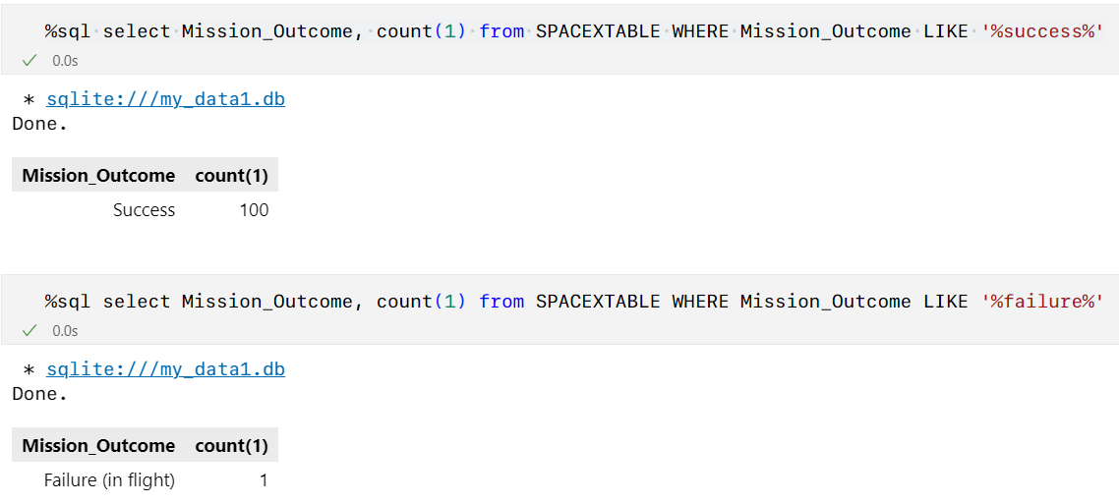
Total Number of Successful and Failure Mission Outcomes
We calculated the total number of successful and failure mission outcomes, using the wildcard ‘%’ in the WHERE SQL statement

Slide 32
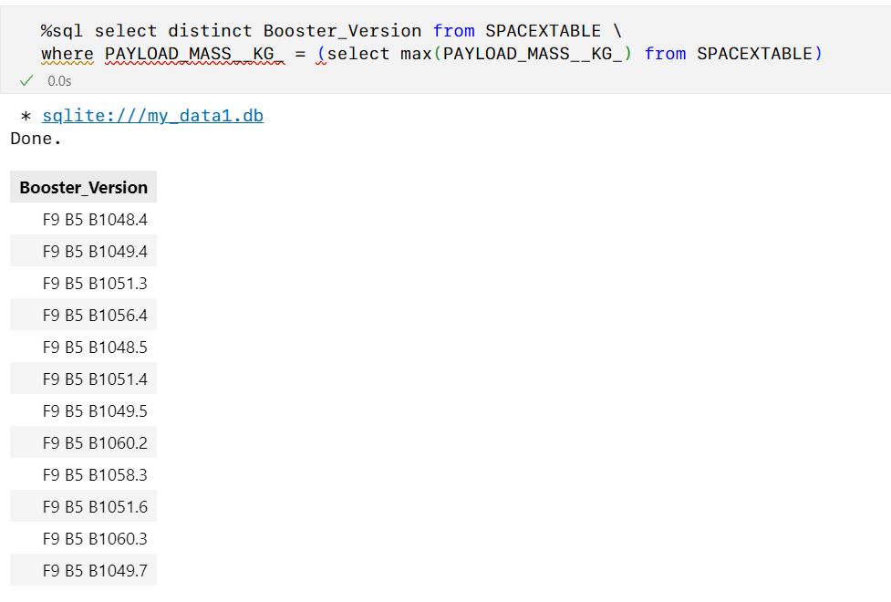
Boosters Carried Maximum Payload
We listed the names of the booster which have carried the maximum payload mass, using a sub-query and the MAX() function

Slide 33
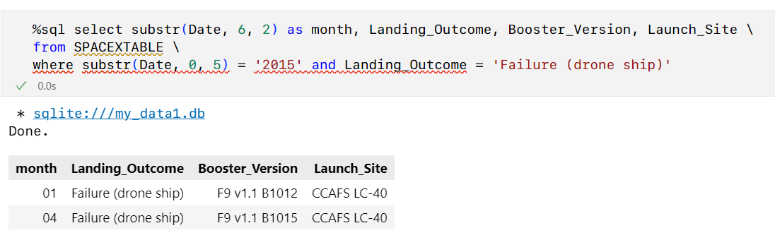
2015 Launch Records
We retrieved the list of the failed landing_outcomes in drone ship in the year 2015, including the booster versions, and launch site names. Since the SQLite hasn’t a MounthName() function natively, we used the sustr(Date, 0, 5) to extract the year from the date field

Slide 34
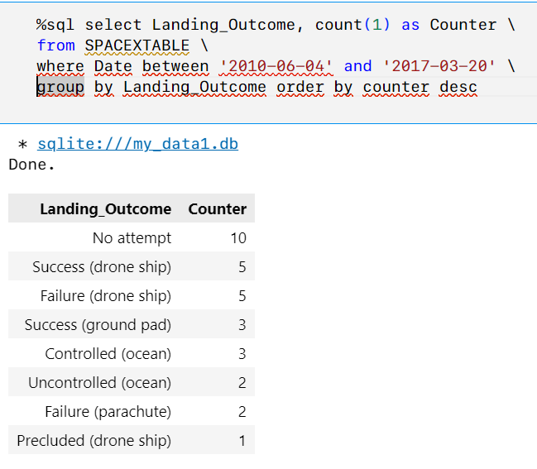
Rank Landing Outcomes Between 2010-06-04 and 2017-03-20
We ranked the count of landing outcomes between the date 2010-06-04 and 2017-03-20, sorting the list in descending order using the BETWEEN statement to filter the data and the GROUP BY statement and COUNT() function to count the number of records for each Landing_Outcome value

Slide 35

Section 3

Slide 36
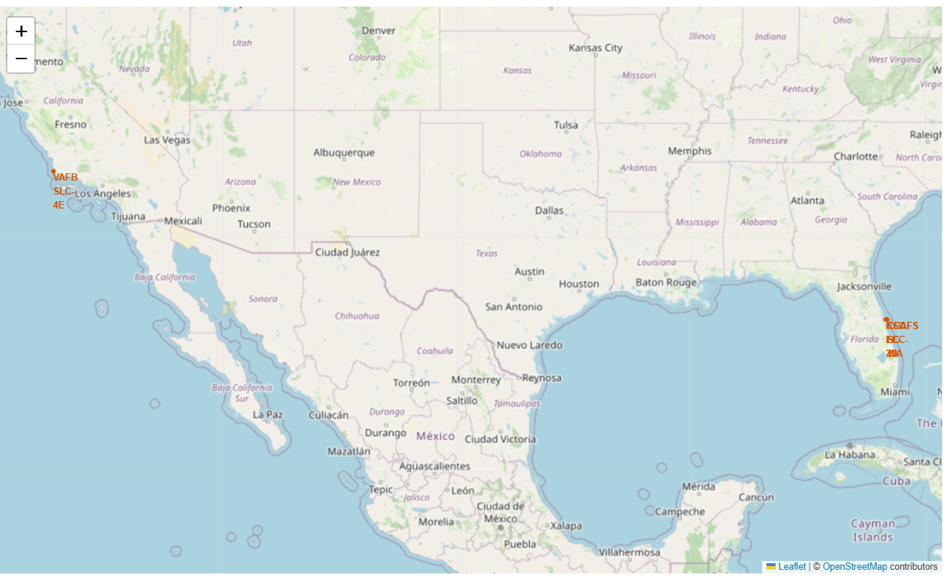
Location for all the launch sites
We used the Folio map marker feature to show the location of all the launch sites on a global map
All the launch sites are located in the United Stated, on the west and east coast

Slide 37
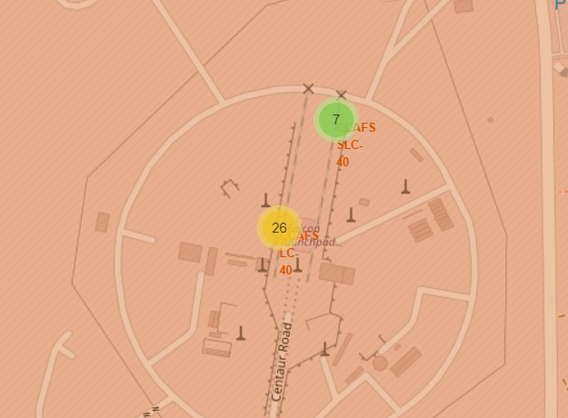
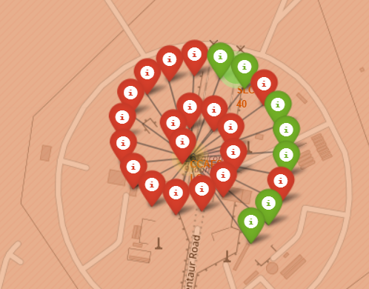
Launch site details
We added additional details to the location on the global map, for each location
Icon indicating the overall number of launch attempts for the specific launch site
The icon representation for each launch with:
A green icon in case of a successful result
A red icon in case of an unsuccessful result

Slide 38
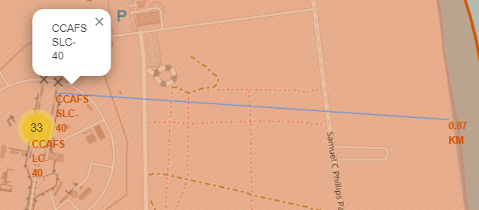
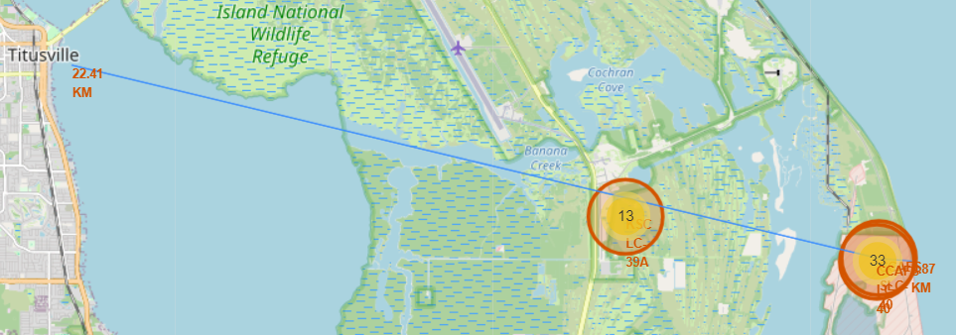
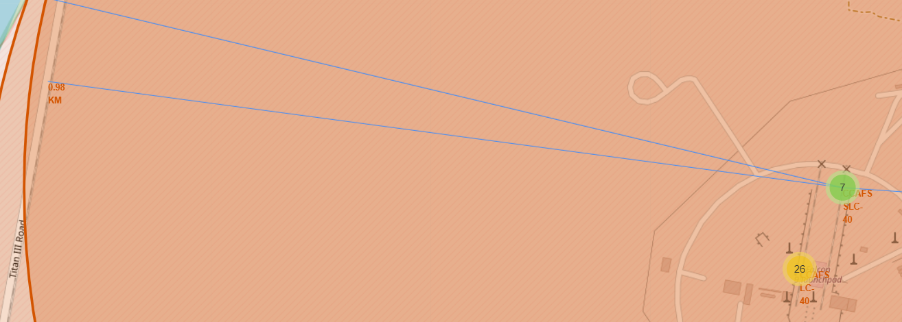
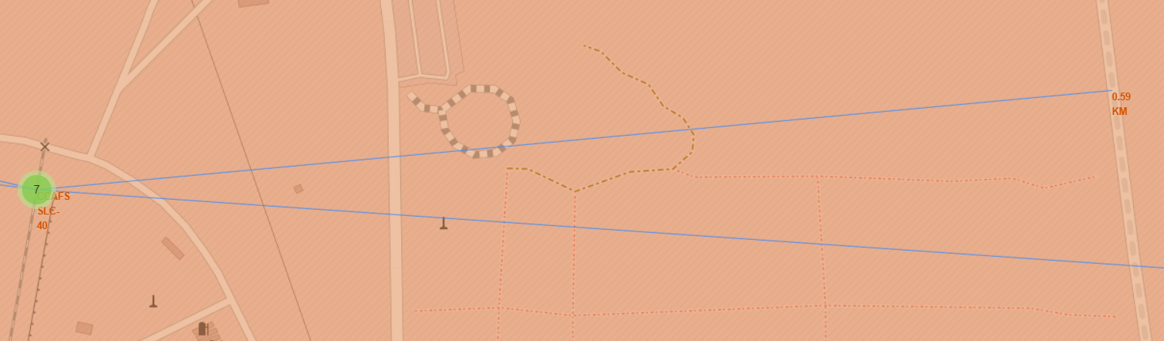
Launch sites and proximity with other sites
Considering the launch site CCAFS SLC-40, we measured distances from relevant sites on the map
Distance from the coast
Distance from the city
Distance from the railway
Distance from the highway

Slide 39

Section 4

Slide 40
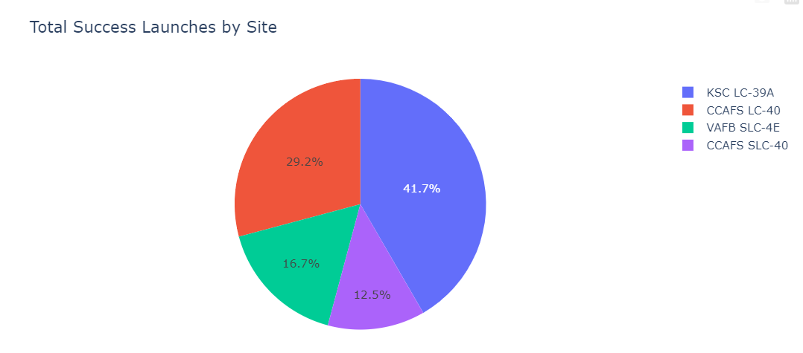
Success ratio for each launch site
We can clearly see that the launch site KSC LC-39A has the highest successful rate from all the sites

Slide 41
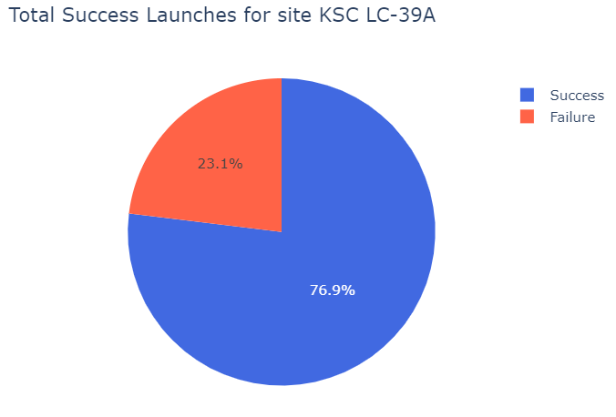
Success launch rate for the KSC LC-39A site
The launch site KSC LC-39A achieved a 76.9% rate of successful launches while getting a 23.1% failure rate

Slide 42
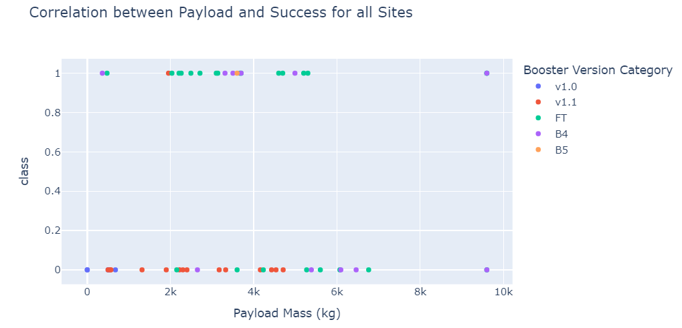
Payload range and launch outcome
The payload range 2000 kg – 6000 kg has higher success rate than other ranges
We have too few data to properly evaluate the success rate with heavyweight oalyloads (>9000kg)

Slide 43

Section 5

Slide 44
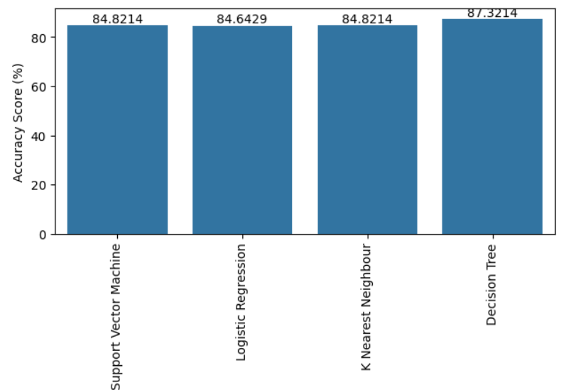
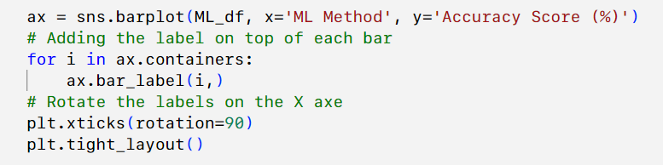
Classification Accuracy
Comparison of the accuracy for each model using a bar chart
The Decision Tree model shows the highest accuracy

Slide 45
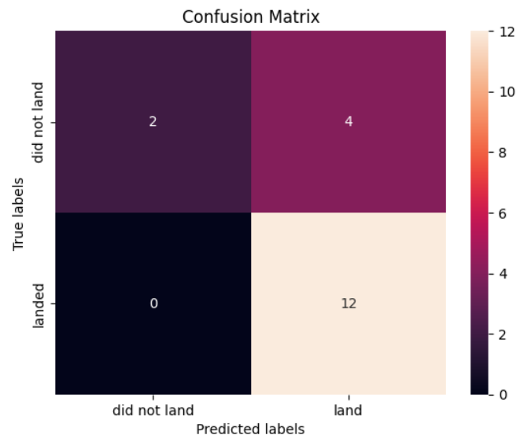
Confusion Matrix
The confusion matrix for the decision tree classifier shows that the classifier can distinguish between the different classes. As you can see in the confusion matrix below, the major problem is the false: unsuccessful landing marked as successful landing by the classifier.

Slide 46
Conclusions
The Tree Classifier Algorithm is the best Machine Learning approach for this dataset.
The low weighted payloads (which define as 4000kg and below) performed better than the heavy weighted payloads.
Starting from the year 2013, the success rate for SpaceX launches is increased, directly proportional time in years to 2020, which it will eventually perfect the launches in the future.
KSC LC-39A have the most successful launches of any sites; 76.9%
SSO orbit have the most success rate; 100% and more than 1 occurrence

Slide 47


